Slide 1
Fleet Electrification Data Analysis Examples January 2023

Slide 2
Disclaimer
Energetics was asked by Metropolitan Energy Center to provide examples illustrating the type of analysis that will be part of the Lawrence, KS fleet assessment project the firms are collaborating on. The following examples are excerpts from previous projects Energetics has completed.
These examples are meant to be generally representative of the analysis typically involved in fleet transition/electrification projects of this nature. They are not intended to imply an exact match with the needs of the Lawrence, KS project.
The analysis provided in this project will be guided by the agreed upon Scope of Work.
Questions and comments should be directed to:
Russ Owens, Program Manager, at rowens@energetics.com

Slide 3
Fleet Inventory Consolidation
Department #1 Vehicle List
Collect vehicle inventory lists from all departments and divisions with responsibility for maintenance and operation of fleet vehicles
Department #2 Vehicle List
Department #3 Vehicle List

Slide 4
Fleet Inventory Consolidation
Combine lists into a comprehensive fleet inventory that can be more easily updated and analyzed

Slide 5
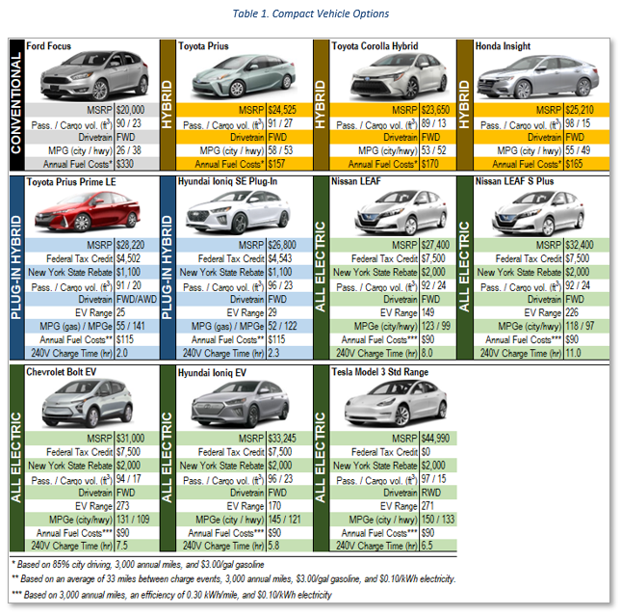
Electric Vehicle Market Availability Analysis
Energetics uses information gathered while refining the fleet inventory to evaluate the potential deployment of electric vehicles (EVs) for all vehicles classes within the fleet
The EV market is expanding and changing rapidly as manufacturers continue to release new models
The vehicle options presented are representative of vehicles immediately available and anticipated within a reasonable timeframe
A vehicle matrix includes EVs that match the use requirements of current fleet vehicles

Slide 6
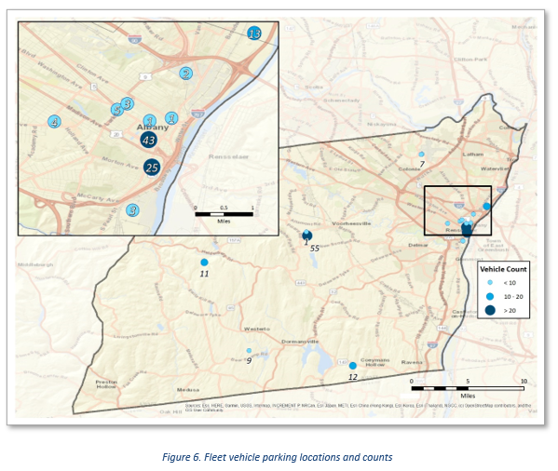
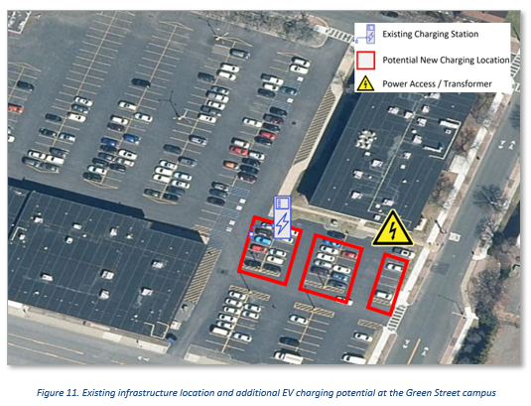
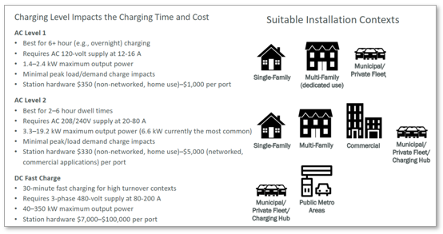
Electric Vehicle Charging Infrastructure Needs Assessment
Energetics evaluates fleet vehicle parking locations, policies, and procedures to develop an assessment of the charging infrastructure investment required to support the transition to EVs
Specific charging infrastructure equipment options are evaluated and explained to provide options for investment
Cost estimates are developed to guide capital planning and budgeting to support efficient EV charging infrastructure planning, procurement, and installation

Slide 7
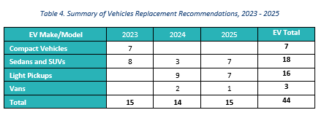
Fleet Electrification Transition Plan
Energetics creates a detailed transition plan as a roadmap to guide the fleet through the electrification process.
Vehicle-specific replacement recommendations

Slide 8
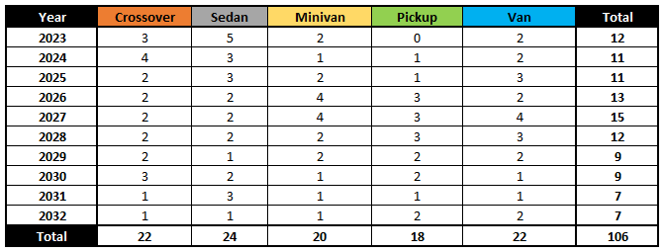
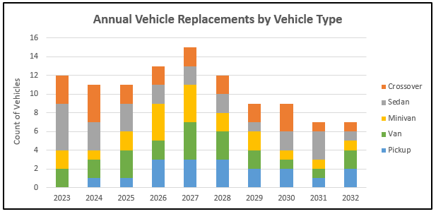
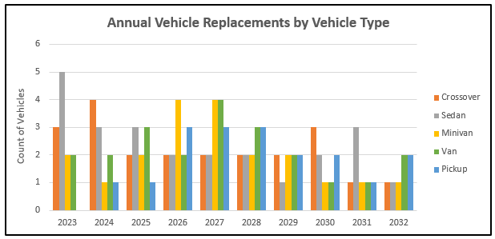
Fleet Electrification Transition Plan
Energetics creates a detailed transition plan as a roadmap to guide the fleet through the electrification process.
Detailed analysis is translated into easily interpreted tables and charts.

Slide 9
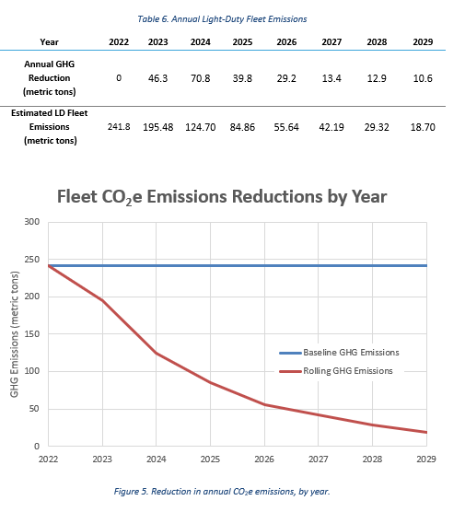
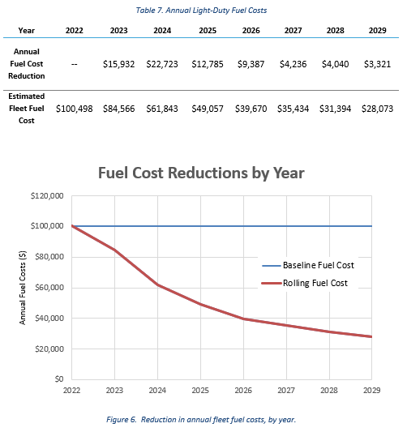
Fleet Electrification Transition Plan
Energetics creates a detailed transition plan as a roadmap to guide the fleet through the electrification process
Emissions reduction modeling
Fuel/energy consumption and cost modeling

