Slide 1
Community-Police Oversight Work Group
Update for City Commission
Tuesday, July 18, 2023

Slide 2
Work Group
City Commission: Community-Police Oversight Work Group
Project Charter
Resolution No. 7474
CityGate study
Work Group is a task force distinct from the Community Police Review Board
12 members: 5 community representatives, 3 members of the CPRB, 2 Police Department Command Staff and 2 Police Officers from the LPOA
Meet for 8 meetings – 6 work sessions and 2 Community Conversations
IAP2 Consult Phase with Facilitator

Slide 3
Work Sessions and Community Conversations
Work Sessions held at Fire Station #5 on the following Mondays from 6:00 – 8:00 pm
May 22
June 5
June 26
July 17
August 14
August 21
August 28
Community Conversations held at Carnegie Building from 6:00 – 8:00 pm
July 10
July 31

Slide 4
Work Group Task: Complaint Process Review and recommendations
Work Group:
Work Sessions – member questions, resource needs to review the complaint process
Community Conversation #1 – understanding community expectations for the process
Work Session – Complaint Process: Presentation and Mapping Exercise
Community Conversation #2
Work Sessions - Draft Recommendations
Final Recommendations

Slide 5
Work Group Task: CPRB, Oversight/advisory/review
Work Group:
Work Sessions – differentiating Work Group from CPRB, leveraging experience
Community Conversation #1 – explore themes of accountability, public trust & oversight
Work Session – reviewing resources
Community Conversation #2
Work Sessions - Draft Recommendations
Final Recommendations

Slide 6
Community Engagement PORTAL: Community Police Oversight Work Group
Frequently Asked Questions format
Agendas
Video recordings, notes
Meeting dates and locations
Key Documents
Resource Documents
Draft Recommendations
Final Recommendations

Slide 7
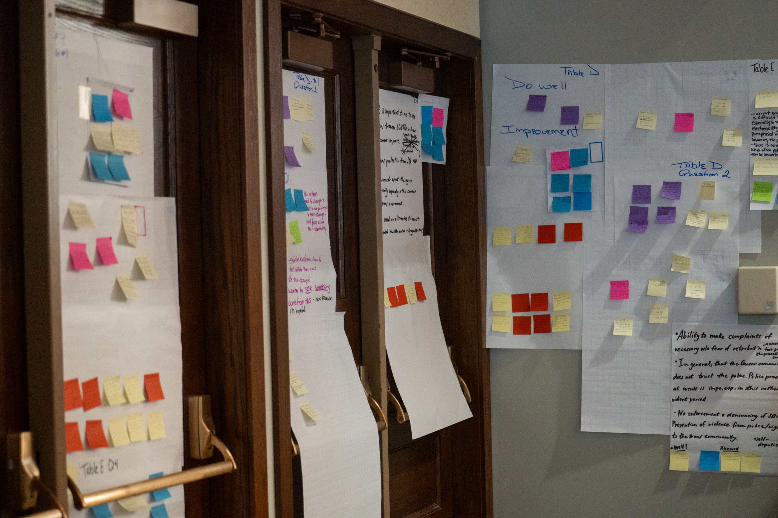
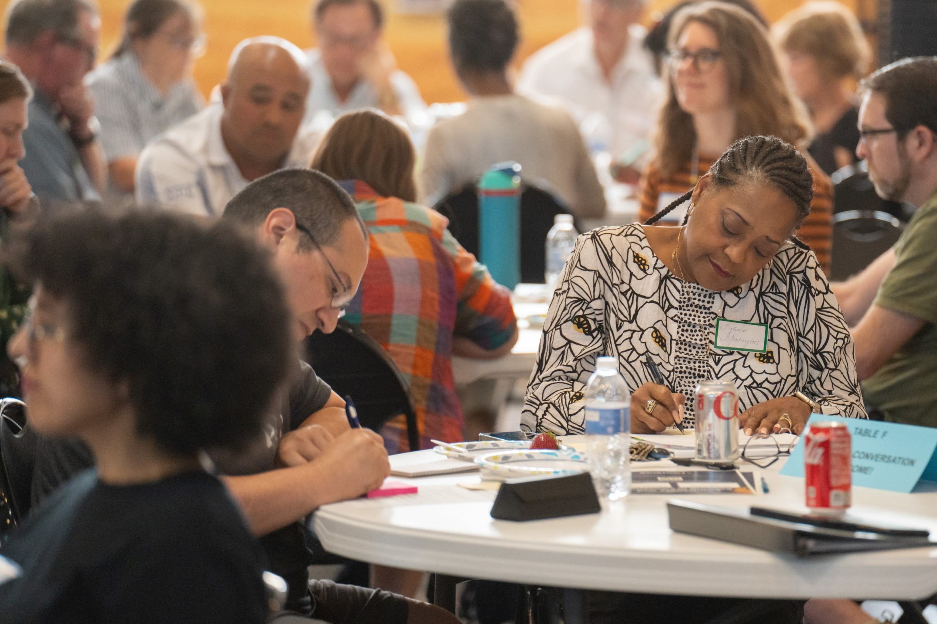
*Update: Community Conversation #1 notes from last week are being typed up now and include...

Slide 8
*Update: Community Conversation #1 notes from last week are being typed up now and include...
300+ comments from in-person small group discussions
Q1: Why is this event important to you? Why did you come here today? (quotes from more than 30 responses)
“To observe. To see if this room represents Lawrence. To listen.”
“Everyone’s experience is different. We see things through different lens.”
“To find out why it has been so difficult to establish an independent police review board.”
“Become increasingly aware that all residents are not treated the same by the police & justice system.”
“Trans protection from SB 180.”
“Want to see something come from this – here because I’m hopeful.”
“ Safety in the community. Respect between Police and the Community can be a positive thing.”
“I am almost completely ignorant on what oversight exists – transparency of the process.”
“To see the community engage. Hoping to share ideas with the Work Group members.”

Slide 9
*Update: Community Conversation #1 notes from last week are being typed up now and include...
Q2: What is important to you about community-police relations in Lawrence that you want to make sure the Work Group understands? (to be themed)
Q3: If you needed to make a complaint about the police, what would give you greater confidence in the complaint process and how it is handled? (to be themed)
Q4: What is important to you about accountability, public trust, and oversight of the police in Lawrence that you want the Work Group to understand? (to be themed, quotes from more than 20 responses)
“If the police screw up – own it, admit it, solve it.”
“That public trust is directly related to the police being accountable for their actions and that there is a process in place to review/oversee problems & complaints.”
Q5: What else did you want to share today with the Work Group that you have not already mentioned? (to be themed)

Slide 10
*Update: Community Conversation #1 notes from last week are being typed up now and include...
Q6: What gives you hope for this work going forward? (quotes from among 20+ responses)
“That people actually show up for a Work Group session like this and that city leaders took the time to host this and organize the heavy lifting.”
“That we have community members willing to show up to events like this and are willing to push the city for accountability.”
“The room has a better representation of how our community looks like then any meetings I have attended over the past five years. There is hope.”
“The attendance tonight seems high - hopefully an engaged community with members of LPD and the public means we can change for the better.”
“Hearing the responses and seeing other citizens engaged in the process.”

Slide 11
NExT Steps
Community Conversation #2
Work Sessions
Resource review
Member discussion of priorities and options
Draft Recommendations
City Commission Consideration

Slide 12
Thank you!
Questions?

